Slide 1
18ECO134T – Sensors and Transducers
Unit III : Session 6 : SLO 1
SRM Institute of Science and Technology
Notes:
Pl use Font Family : Arial Narrow
To enhance the teacher presentations and the overall comprehension of students, it allows to present their lessons in a more dynamic and effective way. Set a Learning Objective:
1. Write an Outline for Key Ideas
2. Give the Presentation About Education a "Why"
3. Share Techniques and Tips for the Topic
4. Teach With Visualizations
5. Use Animations Carefully

Slide 2
CHARACTERSTICS

Slide 3
Pyroelectric sensors are another type of heat-based human detector. These sensors are designed specifically for human detection. The sensor is made of a crystalline material that generates a surface electric charge when exposed to heat in the form of infrared radiation.

Slide 4
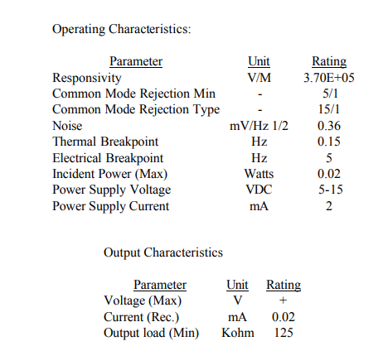
OPERATING CHARACTERSTICS

